Slide 1
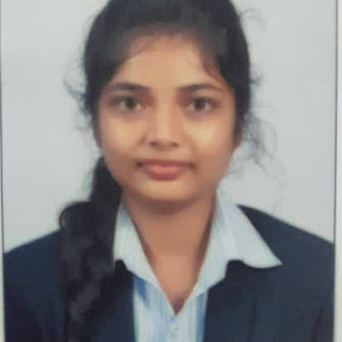


CHETANA PAWAR
Analyst/Software Engineer
Bachelor of Technology
Electrical Engineering : 2018 - 2021
Skills Java 8
Spring Boot
Spring Core
Backend
Spring Boot
Spring Core
Frontend
Rest API
Node Js
Database
SQL database
PostgreSQL
Web Technologies
HTML5
Javascript,ES6
Bootstrap
AddOns
Github
Gradle
Swagger
Eclipse
Additional Details
Proficient Communication
Team management
Mumbai
chetana.pawar@capgemini.com
8600651161
A4
Knowledge of RDBMS Concept.
Comfortable in writing SQL statements like DDL, DML, DQL.
Good understanding of SQL queries.
Knowledge of OOPs concept
Knowledge of Abstraction and Encapsulation
Knowledge of Arrays, Collection, and Generics
Educational Management System
Case study of Education Management System along with API Gateway, Swagger, responsive UI with HTML5, CSS, Bootstrap and React used as User Interface.
https://github.com/Chetana069

